Slide 1
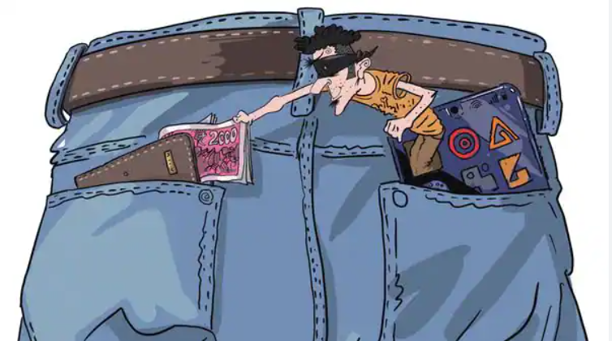
The Impact of Digital Wallets on Spending Habits: Analysing the Influence of Rewards
Presented By:
Viraj Mathur
Priyansha Mahajan
Srishti Bhardwaj
Group 4

Slide 2




What are Digital Wallets?
Digital wallets, also known as e-wallets, are virtual platforms that allow users to store payment information securely and conduct transactions digitally without the need for physical cash or cards.
Key Features:
Transaction history and Notification
Integration with Services
Convenient Payment Storage
Fast Transactions
Enhanced Security
Reward and Discounts
Notes:
The slowdown of the American economy, marked by inflation and rising interest rates, is impacting global markets, leading to reduced investments and hiring freezes in various sectors.

Slide 3
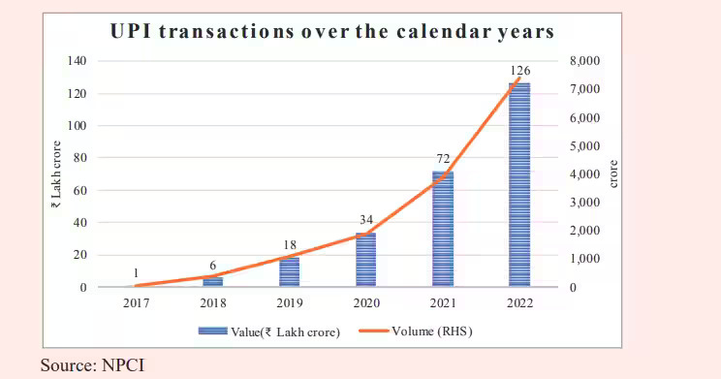

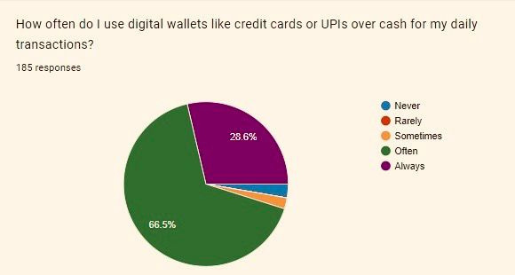
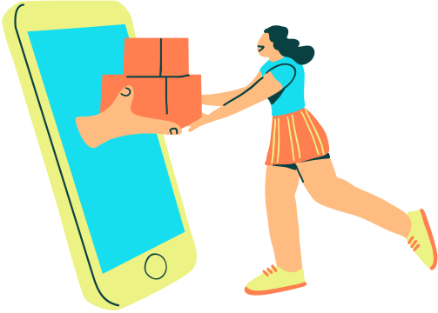
The Rise of Cashless Transactions
COVID -19 in 2020
indias payment landscape has climbed to an average
annuLal rate of around 50%
Online shopping and
banking services
Notes:
The slowdown of the American economy, marked by inflation and rising interest rates, is impacting global markets, leading to reduced investments and hiring freezes in various sectors.

Slide 4
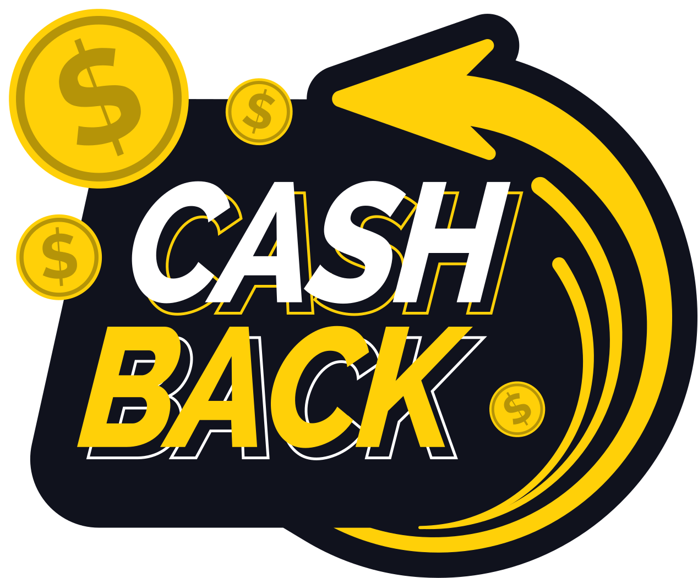

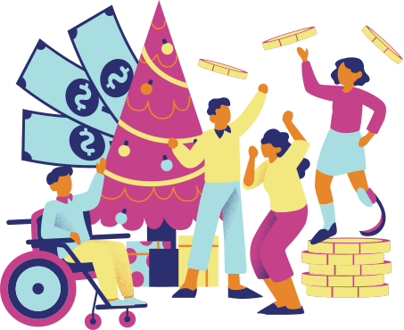
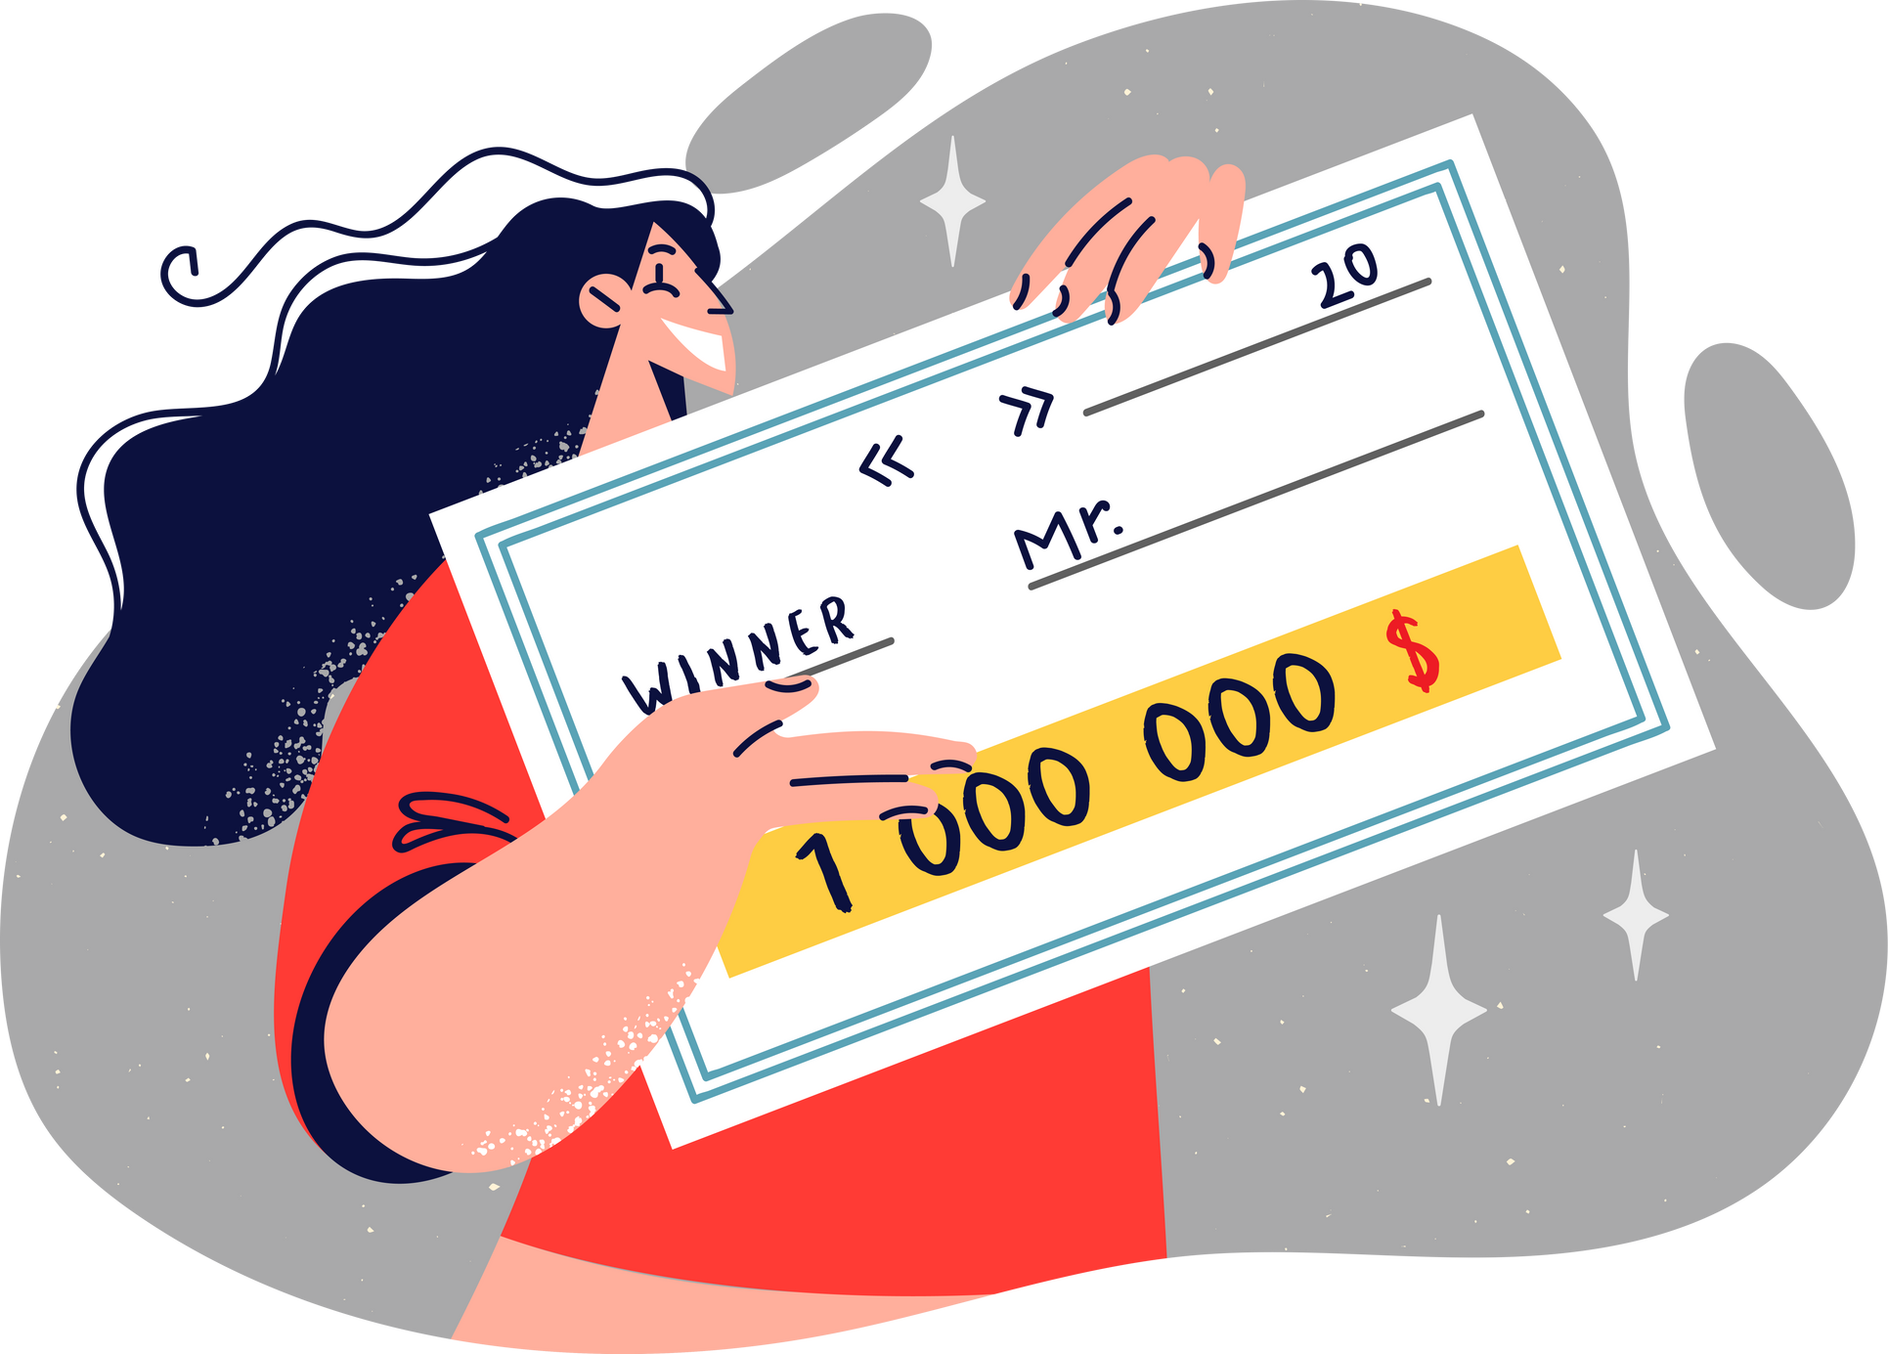

Incentivizing Spending: Types of Rewards
Cashback
Points
Cash Prizes
Referral Bonus
Exclusive Offers.
Discounts
Notes:
The slowdown of the American economy, marked by inflation and rising interest rates, is impacting global markets, leading to reduced investments and hiring freezes in various sectors.

Slide 5

Incentivizing Spending:
How Rewards Drive Consumer Choices
1.Incentivizing Repeat Purchases: Rewards encourage consumers to make repeat purchases to earn more rewards points, cashback, or other incentives.
2. Creating Value Perception: Rewards create a perception of added value for consumers.
3.Building Emotional Connection: Rewards programs can foster an emotional connection between consumers and brands.
4.Differentiation and Competitive Advantage: Rewards programs can differentiate a brand from its competitors and serve as a competitive advantage.
5.Word-of-Mouth Marketing: Satisfied customers who benefit from rewards programs are likely to share their positive experiences with friends and family, effectively serving as brand ambassadors.
Notes:
The slowdown of the American economy, marked by inflation and rising interest rates, is impacting global markets, leading to reduced investments and hiring freezes in various sectors.

Slide 6
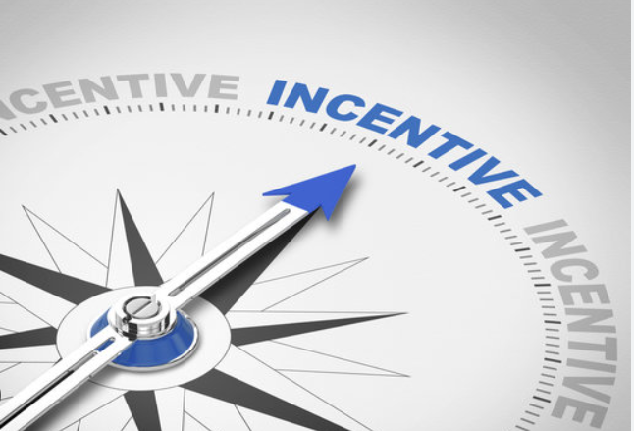
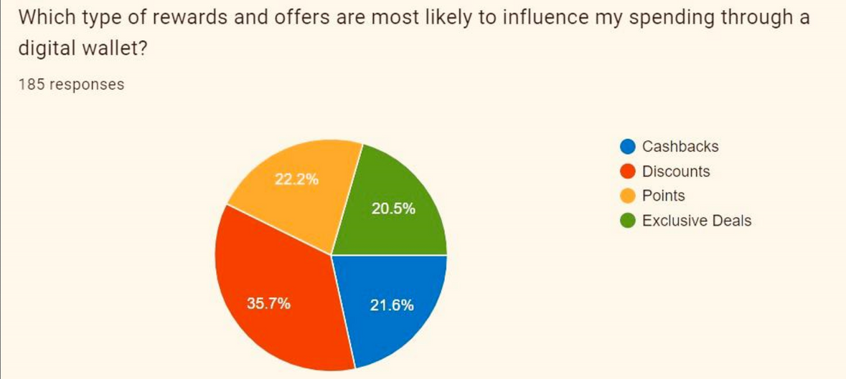
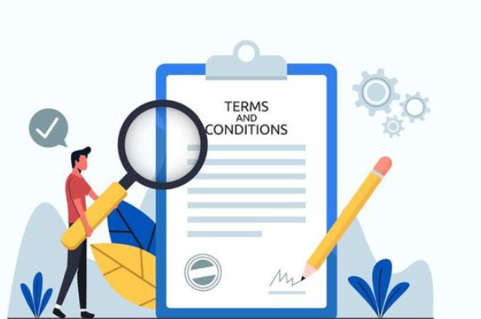
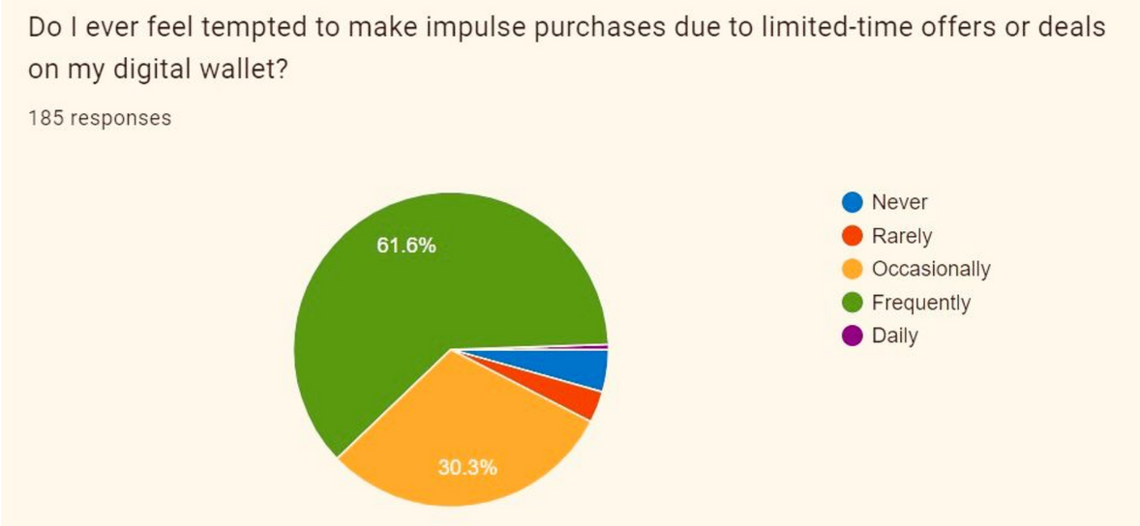
Incentivizing Spending
Notes:
The slowdown of the American economy, marked by inflation and rising interest rates, is impacting global markets, leading to reduced investments and hiring freezes in various sectors.

Slide 7



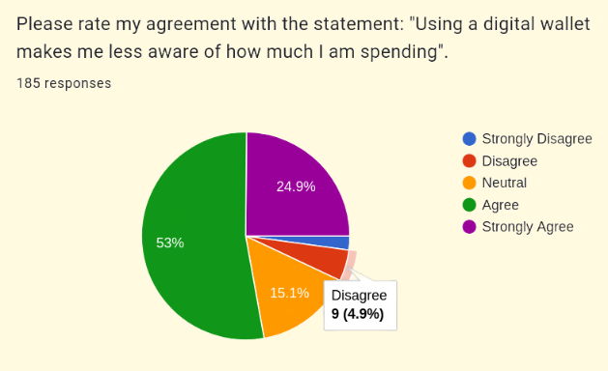
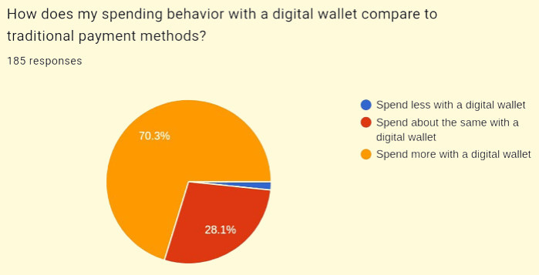

Comparative Analysis:
Spending via Digital Wallets vs. Cash
DIGITAL WALLETS
Transaction Speed and Convenience
Increased Frequency of Transactions
Preference for Rewards and Incentives
CASH
More Conscious Spending
Budgeting and Financial Awareness
Limited Access to Rewards
Notes:
The slowdown of the American economy, marked by inflation and rising interest rates, is impacting global markets, leading to reduced investments and hiring freezes in various sectors.

Slide 8
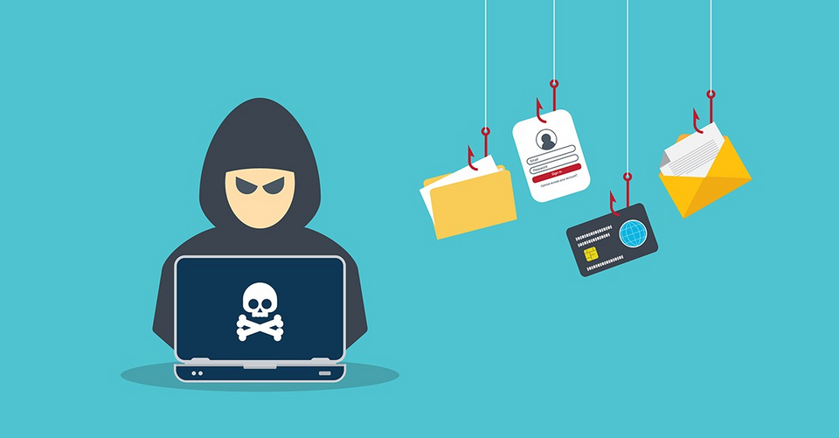

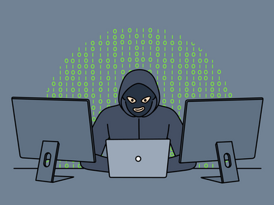
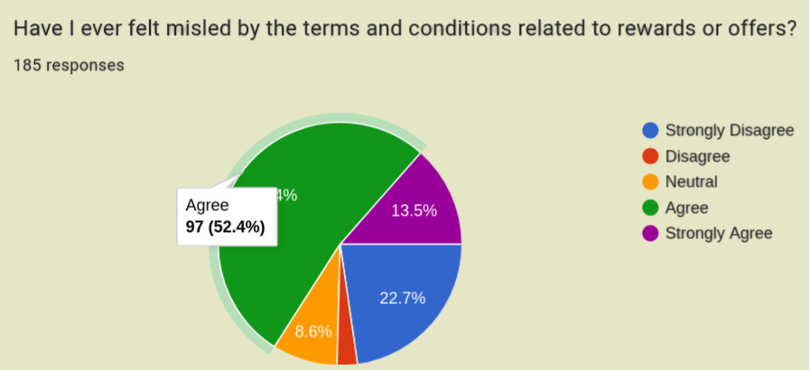
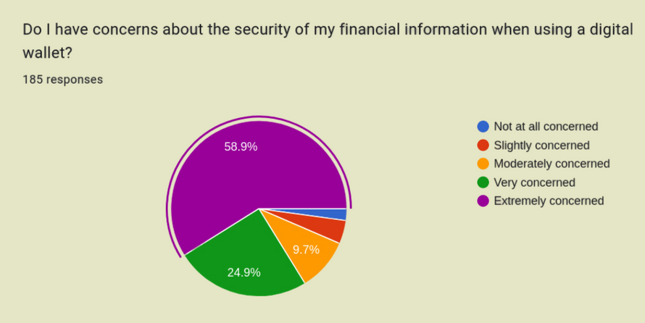

Challenges and Limitations
Data Privacy
Cybersecurity frauds
Potential Overspending
No Savings and Investment
Technological barriers
Notes:
The slowdown of the American economy, marked by inflation and rising interest rates, is impacting global markets, leading to reduced investments and hiring freezes in various sectors.

Slide 9


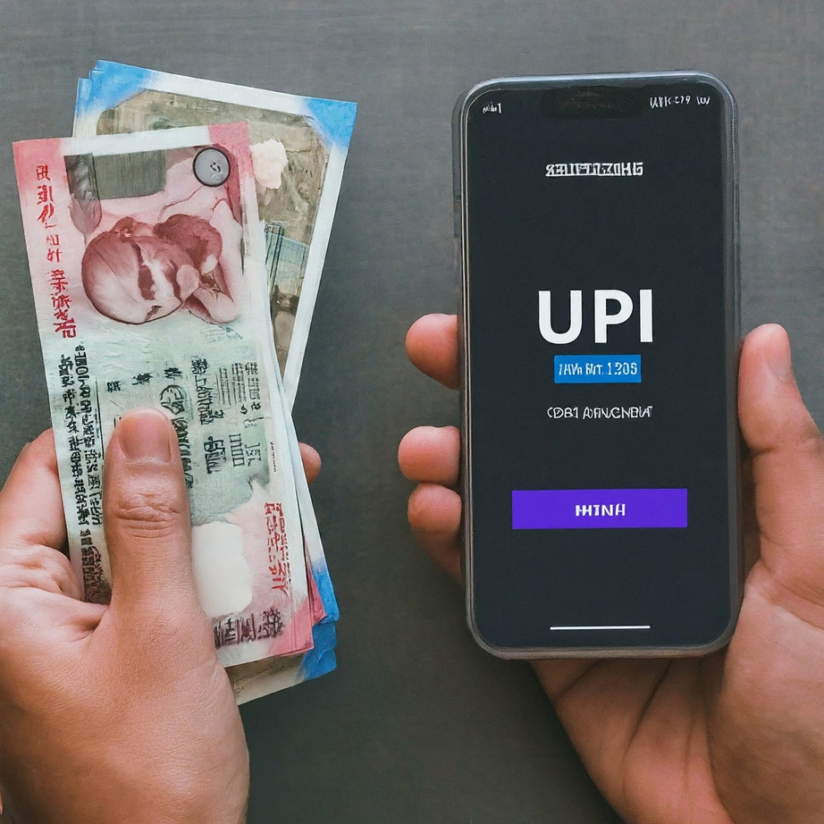
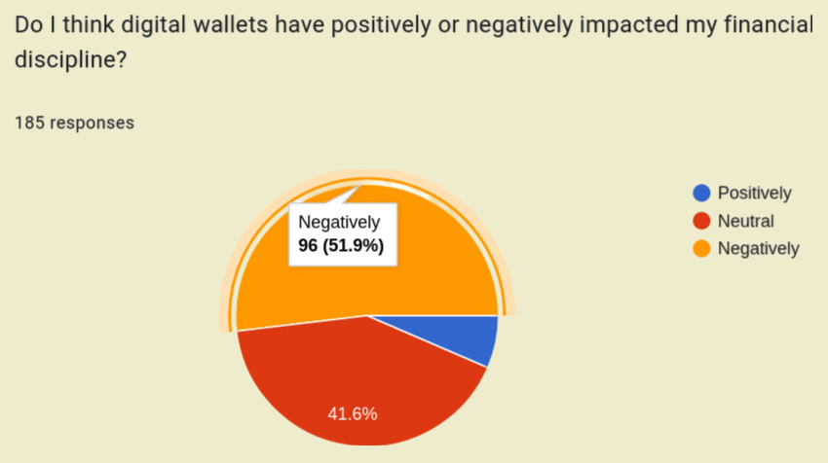
Impact
Positive or Negative?
Notes:
The slowdown of the American economy, marked by inflation and rising interest rates, is impacting global markets, leading to reduced investments and hiring freezes in various sectors.

Slide 10
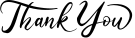

Slide 11


